Slide 1
Deep Learning, GBM classification Using MRM data (2021 AACR )
최정인

Slide 2
Experimental Design on AACR
Training set (551 obs, 69 markers)
Validation set (137 obs, 69 markers)
AMC dataset (122 obs, 69 markers)
Test Performance
Training set
n=551
Val set
n=137
AMC
n=122
Hyperparameter Tuning

Slide 3
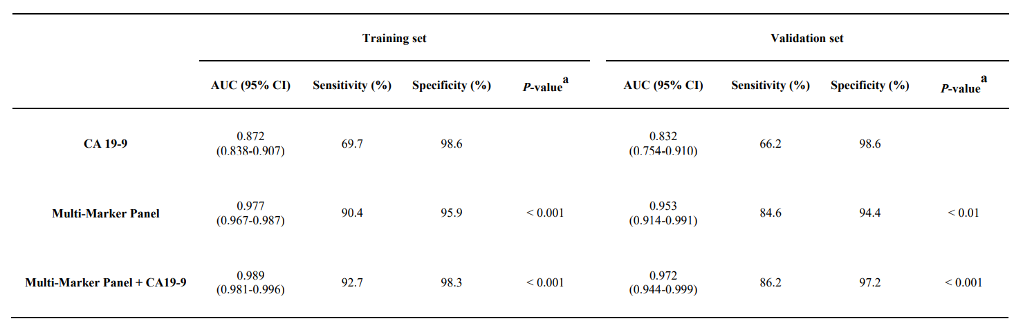
Experimental Design on AACR

Slide 4
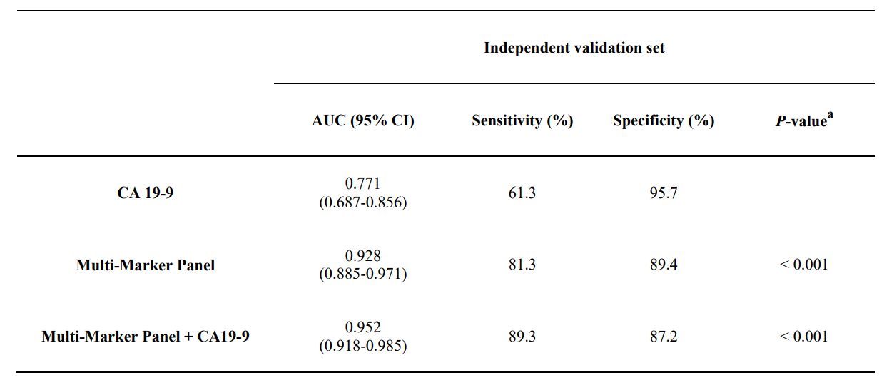
Experimental Design on AACR

Slide 5
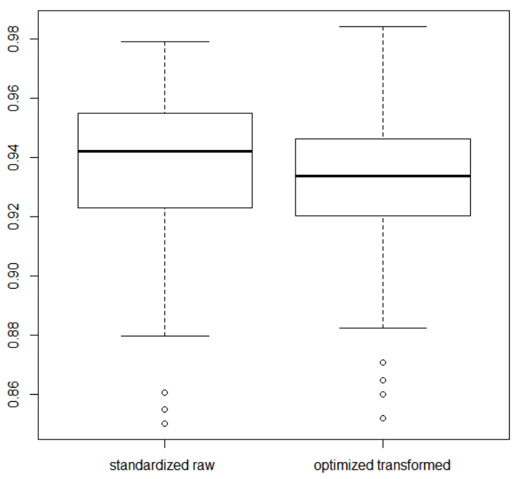
Boxplot of test AUC for 100 train/test set

Slide 6
Hyperparameter Tuning of DL on Train/Validation
Activation function : Rectifier / Tanh / Maxout
Input dropout ratio : 0 / 0.05 / 0.1 / 0.2
Epochs : 20 /30 /40 /50 /60 /70 /80 /90 /100 /200 / 300 / 400 / 500 / 600 / 700 / 800
Epsilon : 1e-4 /1e-5 /1e-6 / 1e-7 / 1e-8 / 1e-9 / 1e-10
Train sample per iteration : 0 / -1 / -2
To specify one epoch, enter 0. To specify all available data, enter -1. To use the automatic values, enter -2
2688 combination

Slide 7
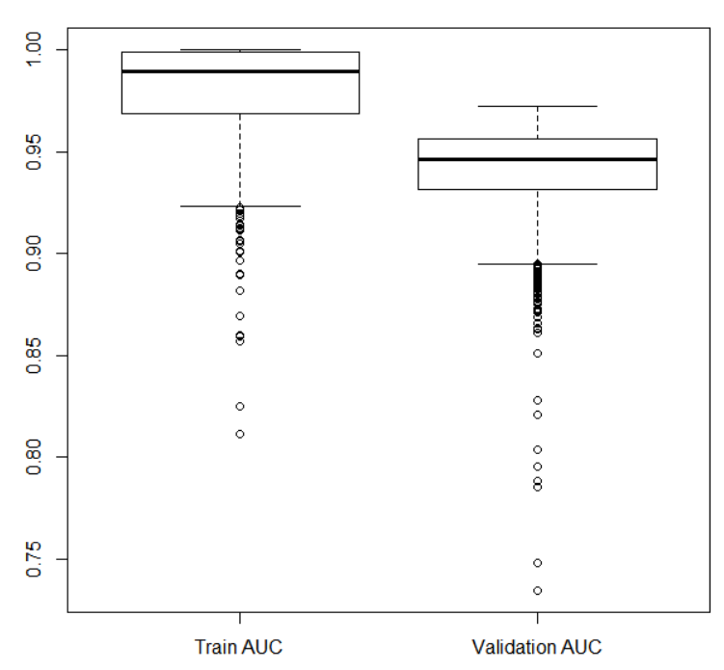
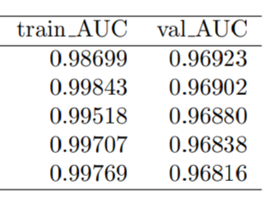
Hyperparameter Tuning of DL on Train/Validation
Train/Val AUC for best 5 model

Slide 8
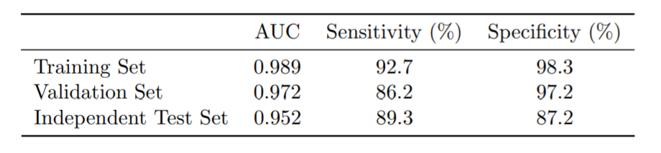
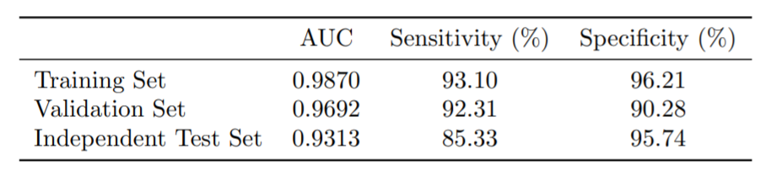
DL performance on Train/Validation/Test
AACR results based on Multi-Marker panel + CA19-9
DL performance on 69 Biomarkers

Slide 9
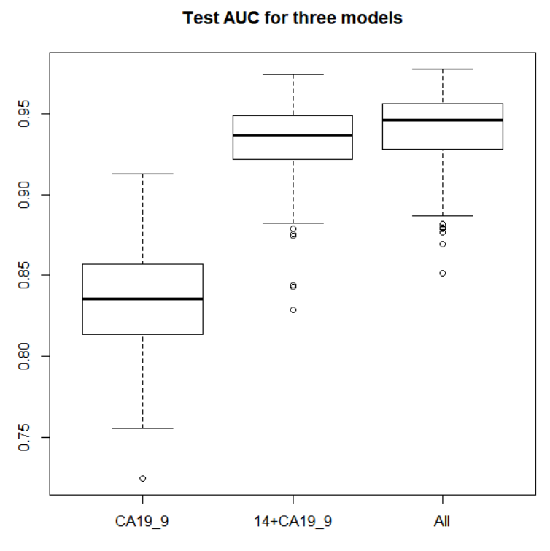
Test AUC boxplot for different biomarkers

Slide 10
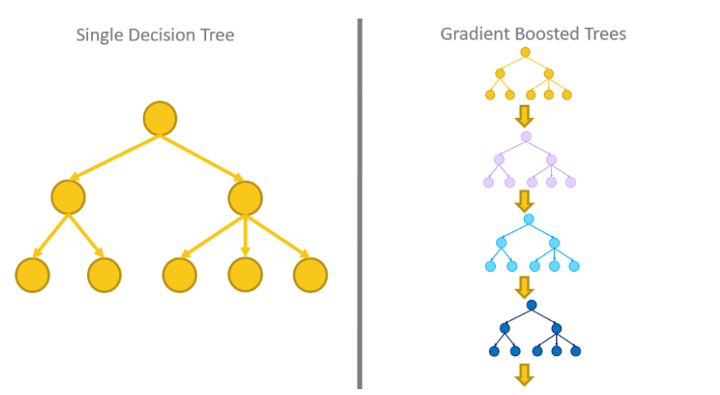
Gradient Boosted Model(GBM)
Gradient Boosting Model is ensemble algorithm
with combining more than on decision trees
Compared to random forest, GBM builds trees in enhancing error of precedent tree model.
Notes:
gradient boosting regression tree는 여러 개의 decision tree를 묶어 강력한 model을 만드는 ensemble기법입니다.
random forest와 달리 gradient boosting model은 이전 tree의 오차를 보완하는 방식으로 tree를 만듭니다.
gradient boosting은 무작위성이 없어 powerful한 pre-pruning이 사용되며
1~5 정도 깊이의 tree를 사용하므로 메모리를 적게 사용하고 예측도 빠릅니다.

Slide 11
Hyperparameter Tuning of GBM on Train/Validation
Learn rate : seq(0.01, 0.1, 0.01)
Max depth : seq(2, 10, 1)
Sample rate : seq(0.5, 1.0, 0.1)
- Specify the row sampling rate (x-axis)
Column sample rate : seq(0.1, 1.0, 0.1)
- Specify the column sampling rate (y-axis)
5400 combination

Slide 12
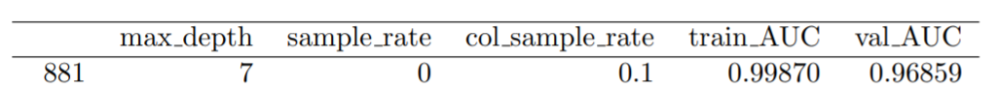
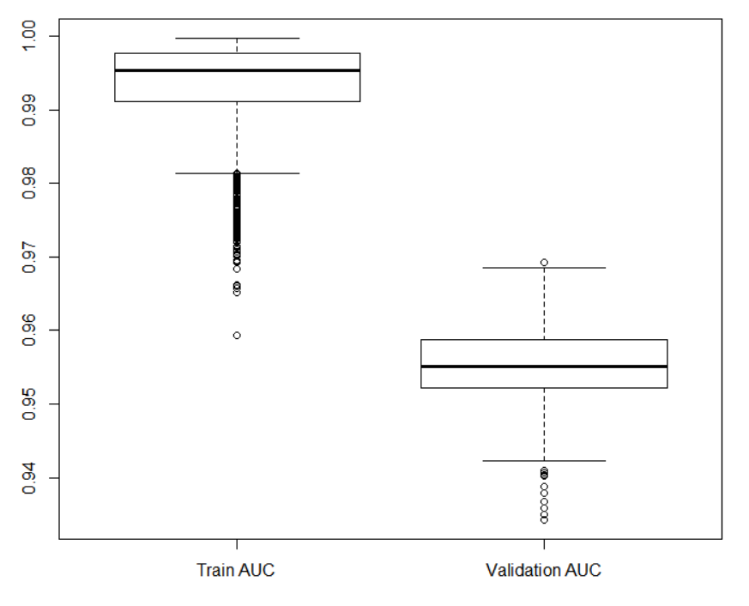
Hyperparameter Tuning of GBM on Train/Validation

Slide 13
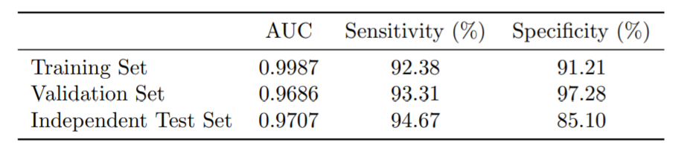
GBM performance on Train/Validation/Test
AACR results based on Multi-Marker panel + CA19-9
GBM performance on 69 Biomarkers

